Slide 1
What is Logging?
Logging is a process that takes applications to a newer level with information logs on how the applications may or may not have performed/executed.
It gives an exact idea of software performance.
Log4j in Selenium is one such logging framework that helps in gathering information in the form of logs or log files.

Slide 2
What is Log4j in Selenium?
Log4j is a logging framework written in Java that provides an easy way for logging in Selenium.
This framework gives out information about everything that goes on during the software execution.
Log4j also provides insight into anything that may have gone wrong during software execution or automation.
Overall, Log4j documents the output in the form of logs that can be examined later for purposes such as auditing small and large-scale Selenium Projects

Slide 3
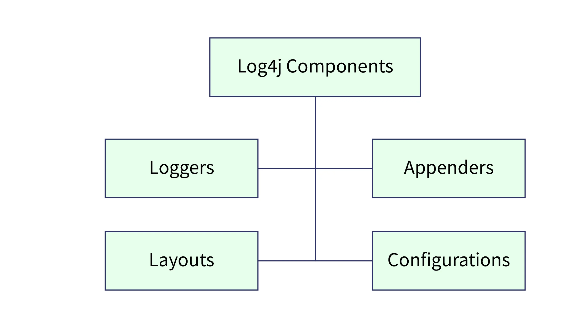
Components of Log4j Selenium

Slide 4
Logger
The function of the logger in Log4j is basically storing and capturing all the necessary logging information that will be generated using the framework.
The loggers also decide which priority is going to be captured.
Logger Class – To fully use the logger, create an instance for a logger class where all the generic methods will be at the user’s disposal, required to use Log4j.
Log Levels – These are the methods that will be used to print the log messages. There are primarily only a few log levels that are used in a script.

Slide 5
Log Levels
ALL – This level will prioritize and include everything in the logs.
ERROR – This level will show messages that inform users about error events that may not stop the application.
WARN – This level will show information regarding warnings, that may not stop the execution but may still cause problems.
DEBUG – This level will log debugging information.
INFO – This level will log the progress of the application.
FATAL – This will print information critical to the system that may even crash the application.

Slide 6
Appenders
The appender basically grabs information from the logger and writes log messages to a file or any other storage location. The following are some of the appenders one can use for Log4j:
FileAppender – This will append the log messages to a file.
RollingFileAppender – It will perform the same function as FileAppender, but users will be able to specify the maximum file size. Once the limit is exceeded, the appender will create another file to write the messages.
DailyRollingFileAppender – It specifies the frequency by which the messages are to be written to the file.
ConsoleAppender – In this, the appender will simply write the log messages in the console.

Slide 7
Layout
The layout is where the format in which log messages will appear is decided. There are several layouts one can use for log messages:
Pattern Layout – The user must specify a conversion pattern based on which the logs will be displayed. Otherwise, it takes the default conversion pattern in case of “no pattern specified”.
HTML Layout – In this layout, the format of logs will be in the form of an HTML table.
XML Layout – This will show the logs in an XML format.

Slide 8
How to add Log4j in Selenium

Slide 9
Step 1: Add Log4j Dependency
<dependency>
<groupId>log4j</groupId>
<artifactId>log4j</artifactId>
<version>1.2.17</version>
</dependency>

Slide 10
Step 2: Import Log4j Classes
import org.apache.log4j.Logger;
import org.apache.log4j.PropertyConfigurator;
The Logger class provides methods to create log statements, while the PropertyConfigurator class is used to load the configuration file of Log4j in Selenium.

Slide 11
Step 3: Load Log4j Configuration
PropertyConfigurator.configure("path/to/log4j.properties");
To configure Log4j in Selenium, you need to load the Log4j configuration file. This file contains the settings that define the behaviour of Log4j, such as logging levels, appenders, and output formats.

Slide 12
Step 4: Define Logger Object
private static final Logger log = Logger.getLogger(YourTestClass.class);
In Log4j, loggers are used to generate log statements.
We need to create a Logger object in your Selenium test script using the getLogger() method from the Logger class.
The getLogger() method takes the name of the class or a unique identifier as an argument.
It is recommended to create the Logger object as a static final variable in your test class.

Slide 13
Step 5: Use Log4j Logging Statements
log.debug("Debug log message");
log.info("Info log message");
log.warn("Warning log message");
log.error("Error log message");
log.fatal("Fatal log message");

Slide 14
Step 6: View Log Output
The log output can be directed to different destinations based on your Log4j configuration.
For example,, if you have specified a file appender, the log statements will be written to the specified log file.

Slide 15
Why to use Log4j in Selenium?
Log4j logging framework can help in debugging applications easily. With different log levels, it becomes easier to sort information based on categories.
The logging framework is open source and can help in logging in different log levels and suppress logs in different environments – which ultimately improves application performance.
The framework produces better output in general.
With three components and clarity in usage, it becomes easier to use and configure log4j in Selenium.
The setup is easy and free of cost, making it more accessible for faster debugging.

Slide 16
Log4j.properties
# Define the root logger level and appender
log4j.rootLogger=INFO, RollingAppender
# Define the rolling appender
log4j.appender.RollingAppender=org.apache.log4j.DailyRollingFileAppender
log4j.appender.RollingAppender.File=logs/app.log
# Define the rolling appender's layout
log4j.appender.RollingAppender.layout=org.apache.log4j.PatternLayout
log4j.appender.RollingAppender.layout.ConversionPattern=%d [%t] %-5p %c - %m%n
# Define the rolling appender's date pattern for rolling files daily
log4j.appender.RollingAppender.DatePattern='.'yyyy-MM-dd

Slide 17
File Appender
log4j.rootLogger=INFO, file
log4j.appender.file=org.apache.log4j.FileAppender
log4j.appender.file.File=logs/example.log
log4j.appender.file.layout=org.apache.log4j.HTMLLayout

